Slide 1
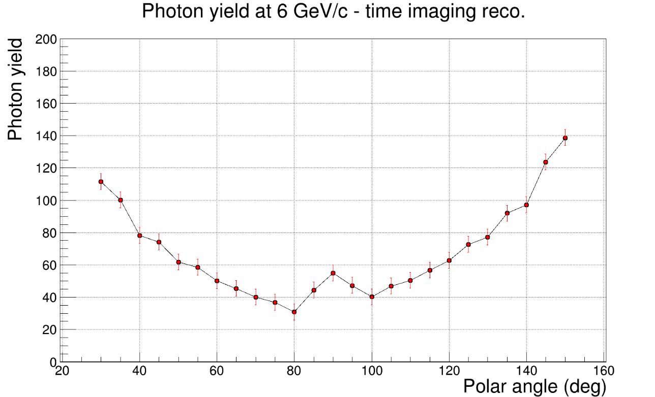
Timecut 0.5 and timeres 0.1

Slide 2
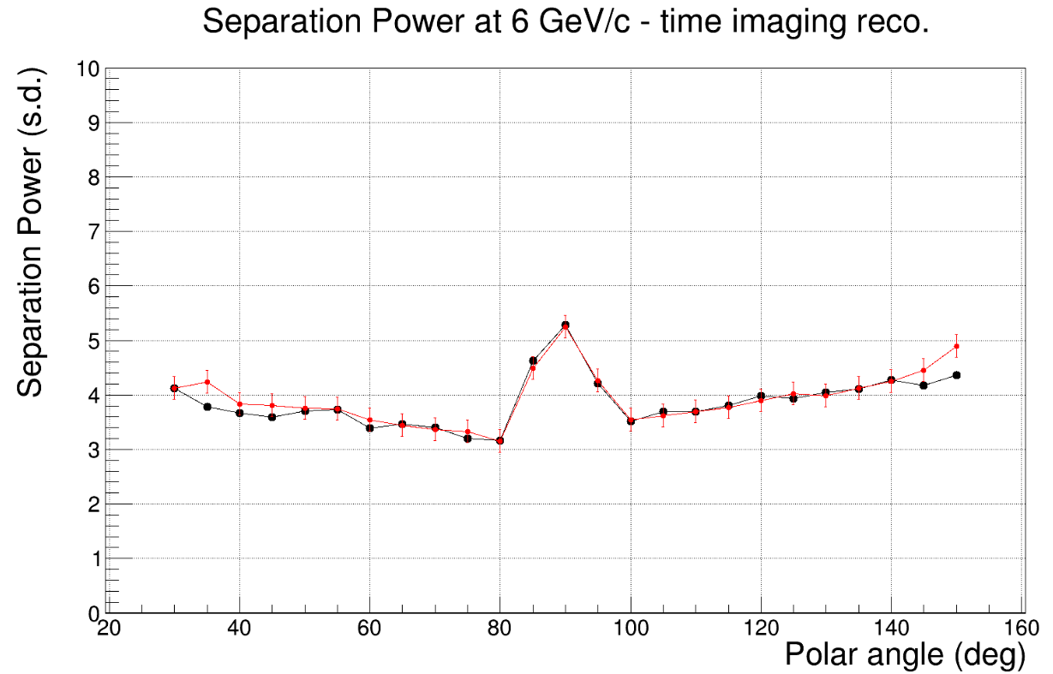

Slide 3
Timecut 0.5 and timeres 0.2

Slide 5
Timecut 0.5 and timeres 0.01

Slide 6
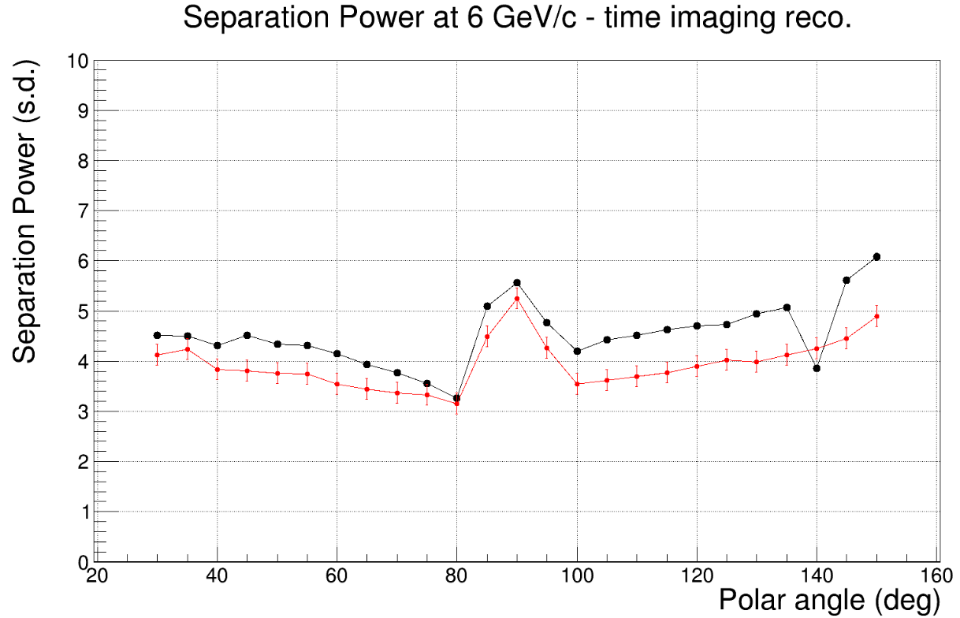

Slide 7
Timecut 0.05 and timeres 0.1

Slide 8
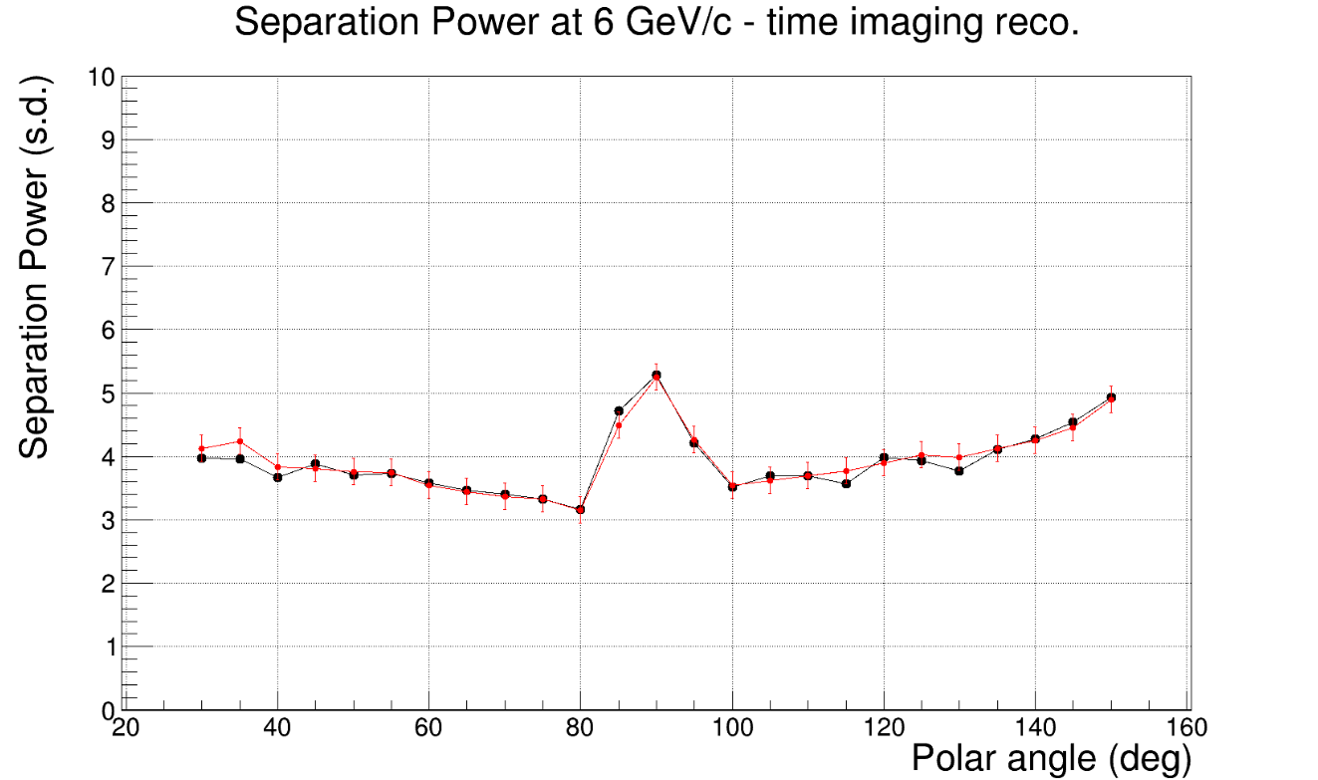

Slide 9
Timecut 0.05 and timeres 0.01

Slide 10
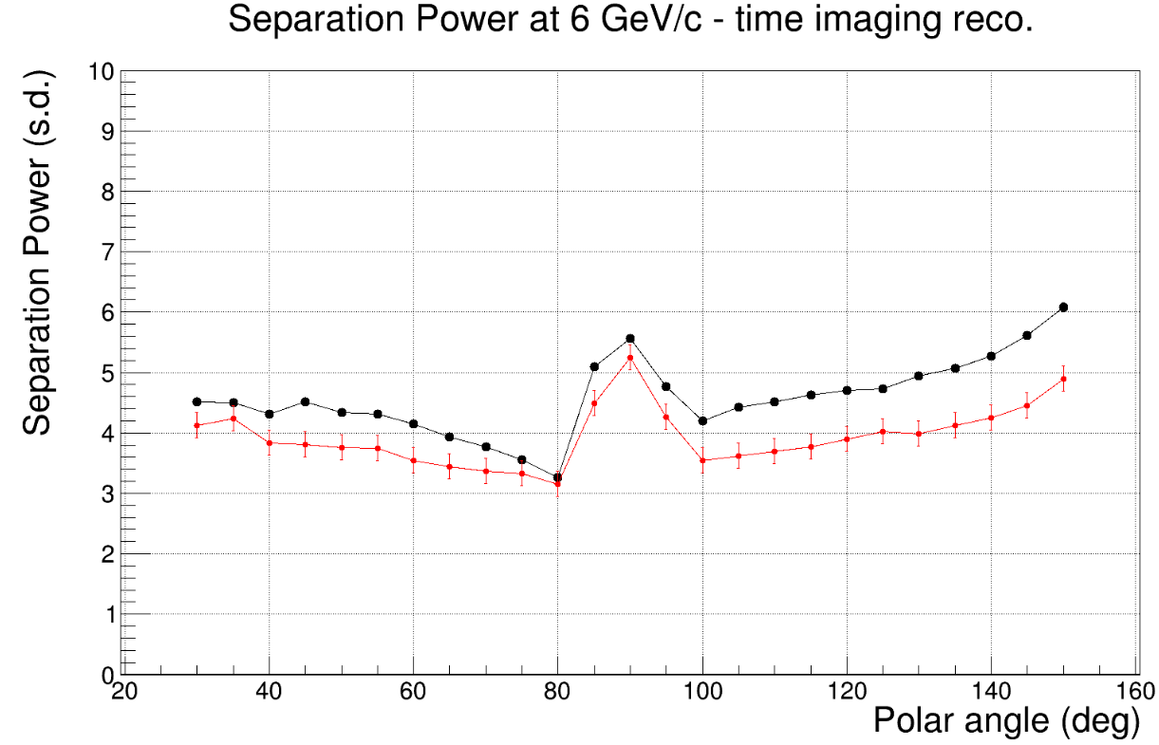

Slide 11
Timecut 0.05 and timeres 0.2

Slide 12
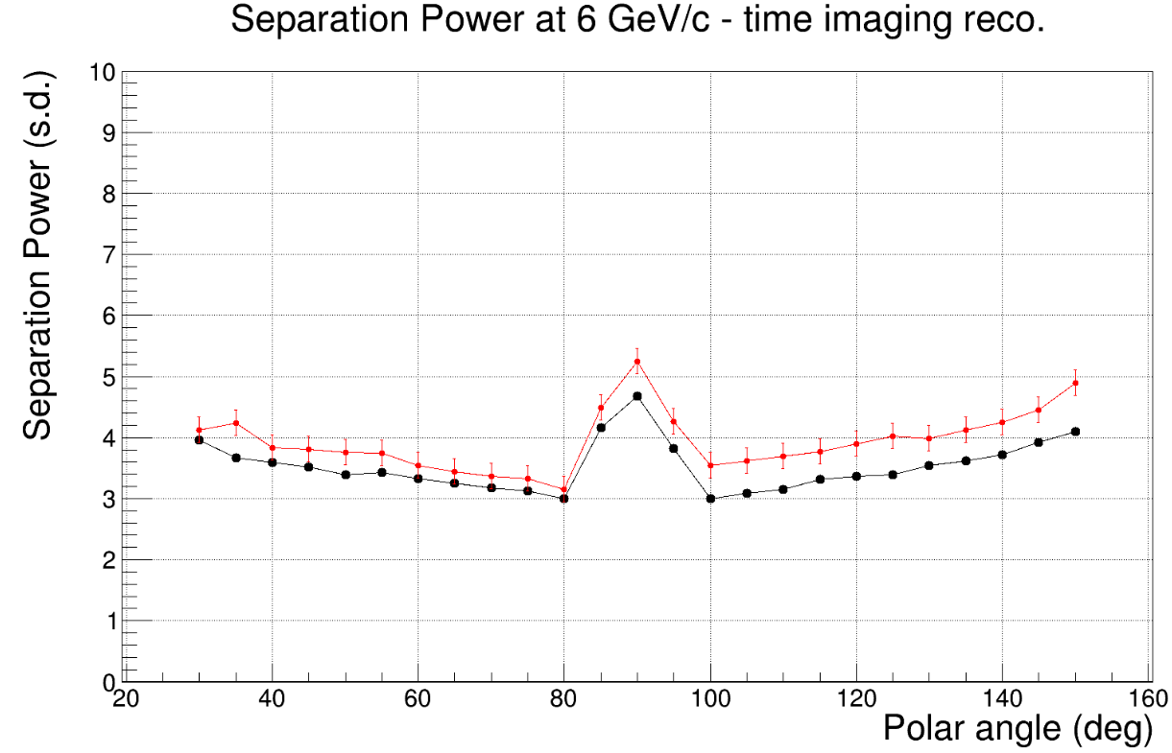

Slide 13
Timecut 0.5 and timeres 0.1

Slide 15
Timecut 0.5 and timeres 0.01

Slide 16
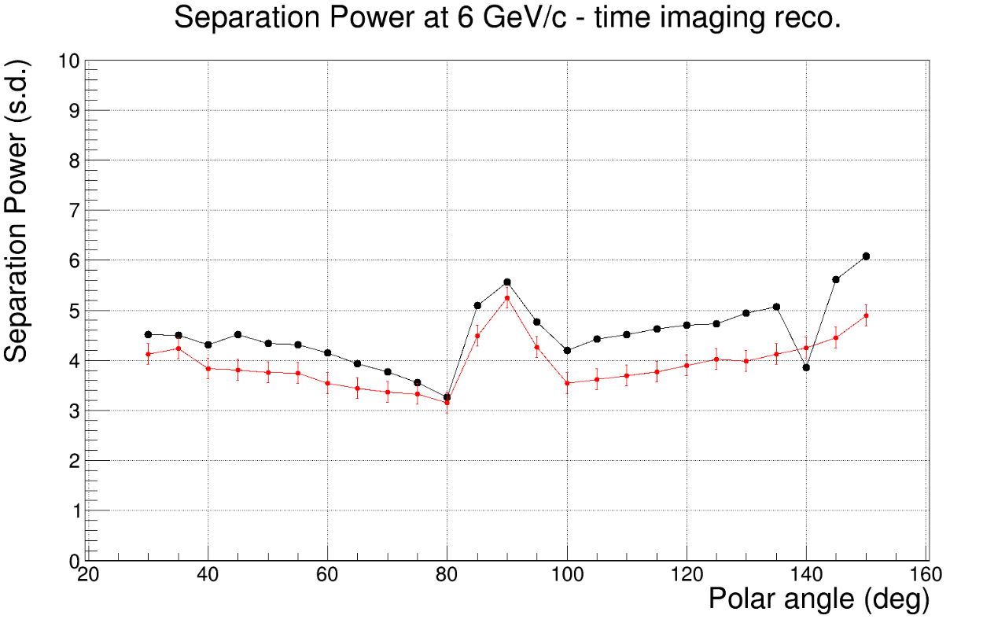

Slide 17
Timecut 0.5 and timeres 0.2

Slide 18
